Slide 1



ATLIQ
HARDWARES
AD_HOC INSIGHTS
CONSUMER GOODS
A.Abhilash reddy

Slide 2
About AtliQ Hardwares
AtliQ Hardwares is one of the leading hardware manufacturing companies.
The company specializes in a wide range of products including:
Accessories
Networking equipment
Desktops
Peripherals
Storage devices
It has a global customer base, serving markets across multiple regions.

Slide 3
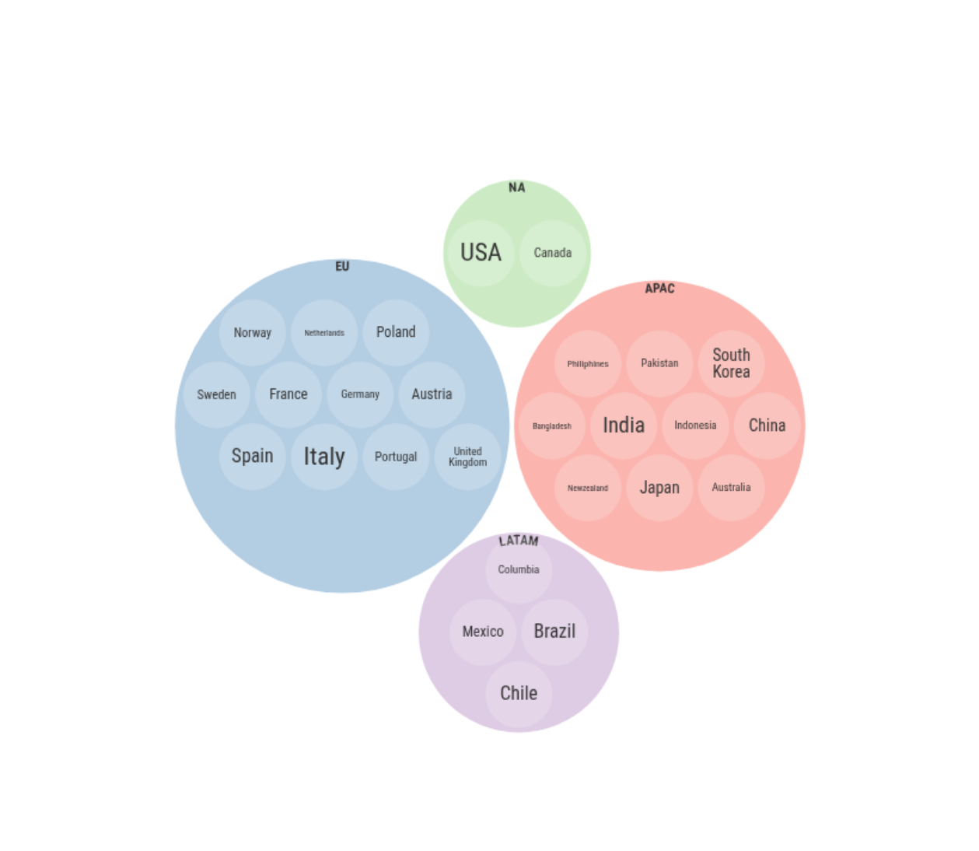


AtliQ Hardwares: Global Presence
The company has expanded its operations into 4 major regions and currently serves 27 countries worldwide.

Slide 4
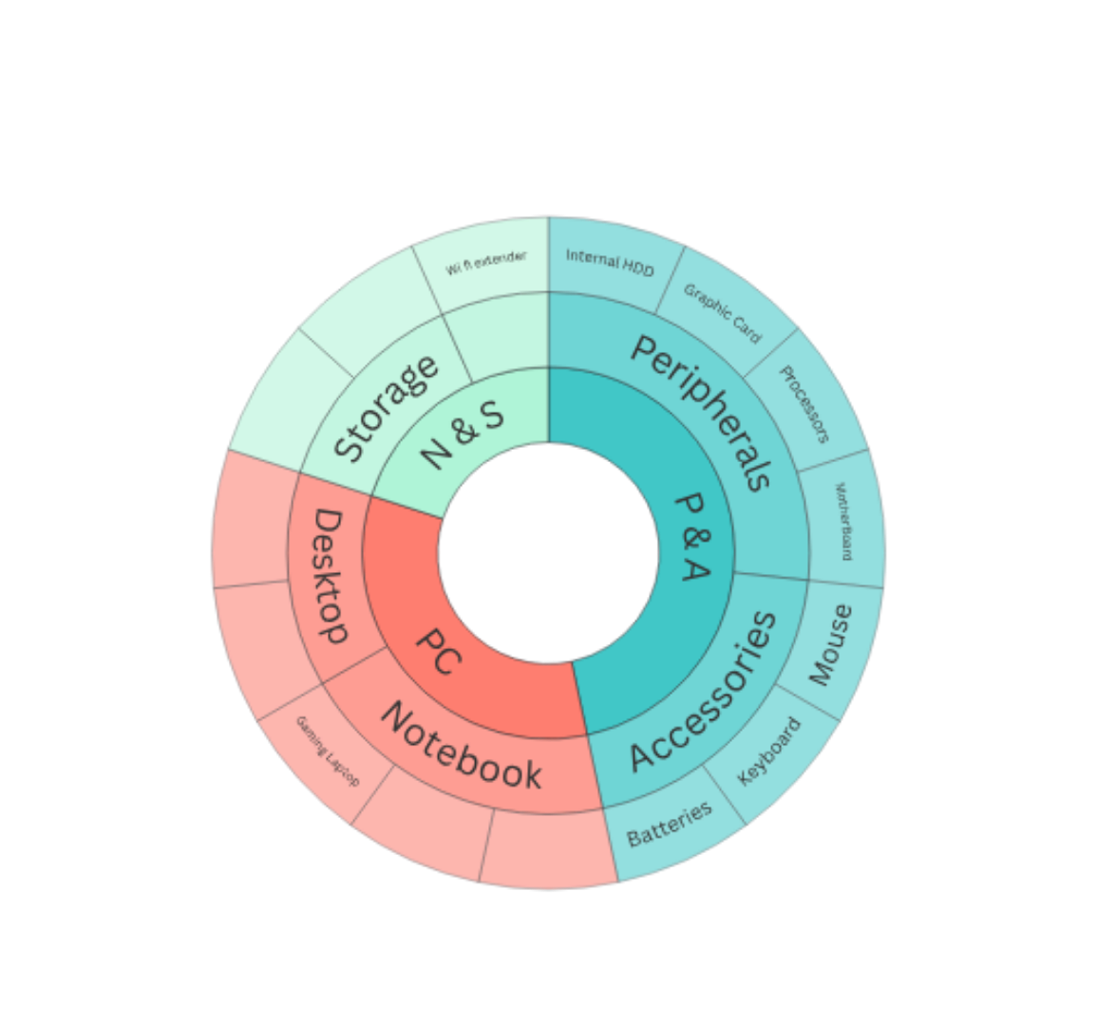
Lets Discusses About Products !!!
Here is the Products hierarchy
DIVISION
SEGMENT
CATEGORY

Slide 5
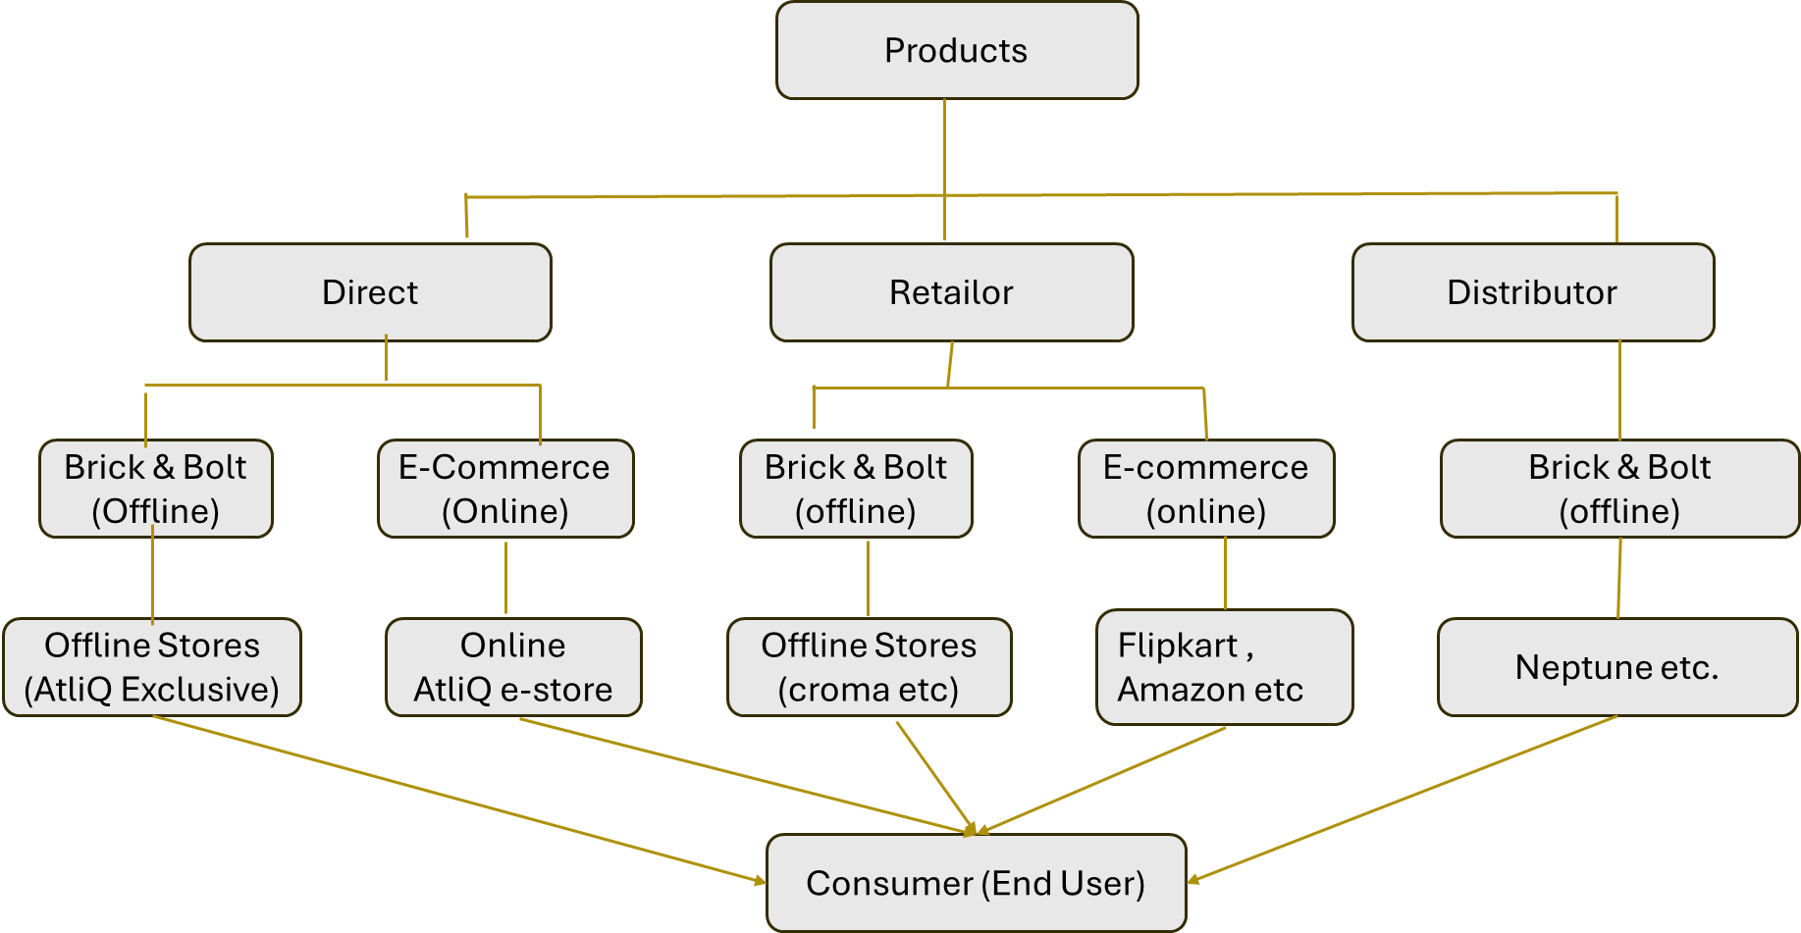
Production -to-end Consumer Flow Structure
channels
channels
Platforms
Platforms
Customers
Customers
Customers
End User

Slide 6
Problem Statement
Atliq Hardwares, a leading computer hardware manufacturer with global presence, lacks timely and actionable business insights. The top management often faces delays in decision-making due to the absence of quick ad-hoc analysis from available data.
Objective
To address this gap, a data analysis project was initiated using SQL to solve 10 real-world ad-hoc business queries. The goal is to extract actionable insights that support executive decisions and showcase the impact of data-driven analysis.

Slide 7
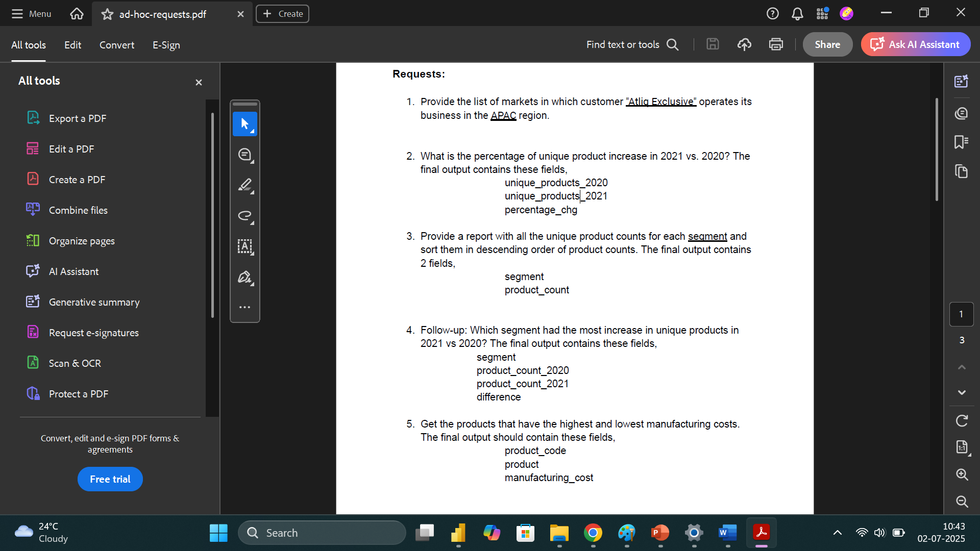
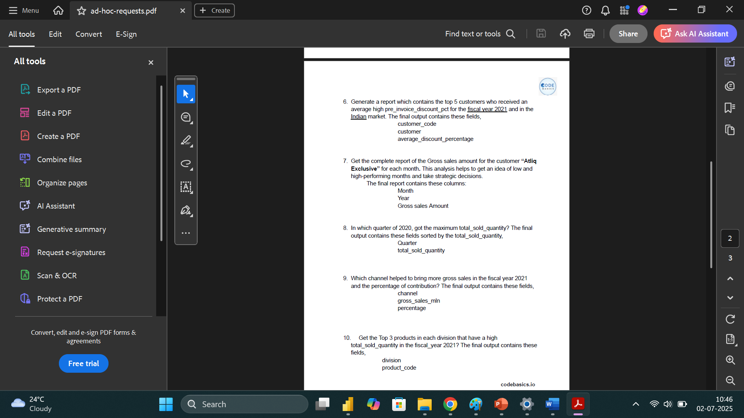
ad-hoc-requests

Slide 8
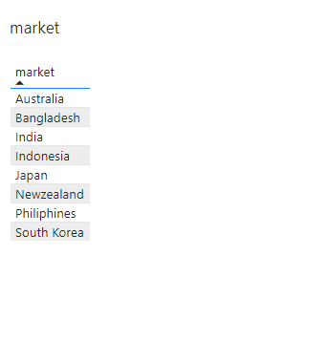
01
Provide the list of markets in which customer "Atliq Exclusive" operates its business in the APAC region.
KEY POINTS
AtliQ Hardwares is present in 10 APAC countries, and
'AtliQ Exclusive' is available in 8 of them
AtliQ Hardware has a global presence across 27 countries.
Among these, AtliQ Exclusive stores operate in 16 countries —
with 8 located in the APAC region alone — highlighting the brand’s strong footprint in this Region

Slide 9
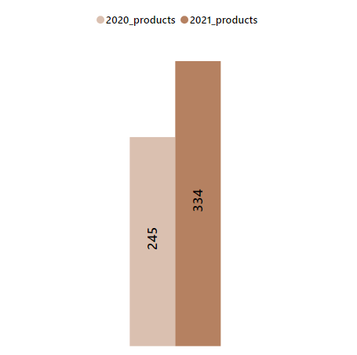
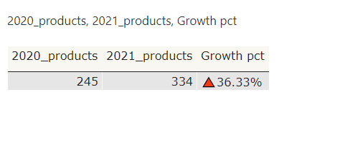
02
What is the percentage of unique product increase in 2021 vs. 2020?
KEY POINTS
AtliQ Hardware has introduced 36% more new products, increasing the total count from 245 in 2020 to 334 in 2021

Slide 10
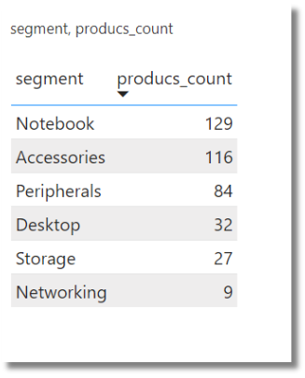
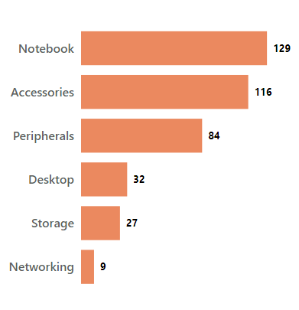
03
Provide a report with all the unique product counts for each segment and sort them in descending order of product counts.
KEY POINTS
The company has a strong market presence in the notebook, accessories, and peripherals segments, offering unique products. However, it needs to strengthen its position in the desktop, storage, and networking segments.

Slide 11
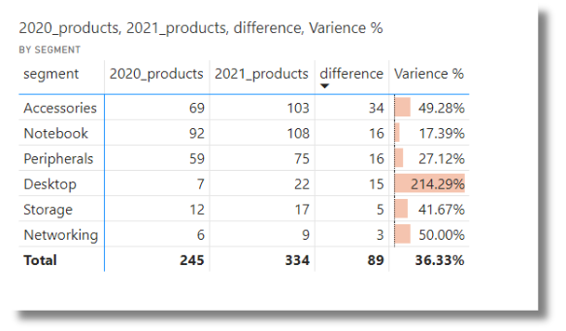
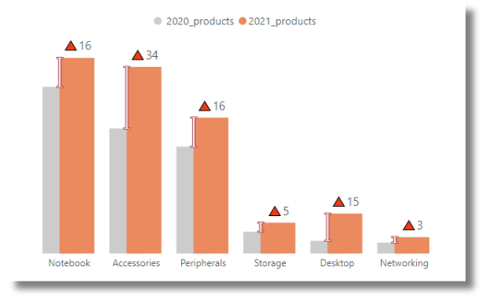
04
Which segment had the most increase in unique products in 2021 vs 2020?
segment,product_count_2020,product_count_2021 difference
KEY POINTS
In the Accessories segment, they introduced 34 new products, marking a 49% growth compared to last year. This has helped strengthen their new product portfolio in accessories. In the Desktop segment, they launched 15 new products — a massive 210% increase from last year , bringing the total to 22. Network and Peripherals segments showed decent growth, while Storage and Networking still require significant improvement.

Slide 12
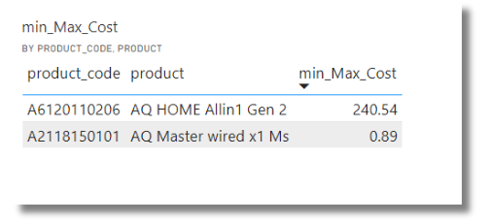


05
Get the products that have the highest and lowest manufacturing costs.
product_code product manufacturing_cost
Min Cost
Maximum Cost
$0.89
$240.54
Mouse
Personal Desktop
KEY POINTS
Minimum Cost : AQ Master wired x1 Ms from mouse Category has the lowest Manufacturing price
Maximum Cost: AQ HOME Allin1 Gen 2 from Personal Desktop has the Highest Manufacturing price

Slide 13
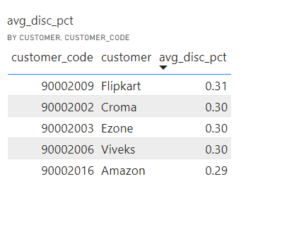
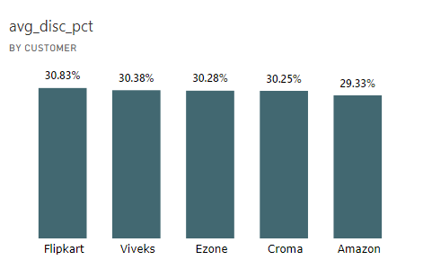
06
Generate a report which contains the top 5 customers who received an average high pre_invoice_discount_pct for the fiscal year 2021 and in the Indian market.
KEY POINTS
In the Indian market, there are a total of 16 customers. Among them, the top 5 customers have received the highest pre-invoice discounts, with Flipkart leading at 31% followed by Croma

Slide 14
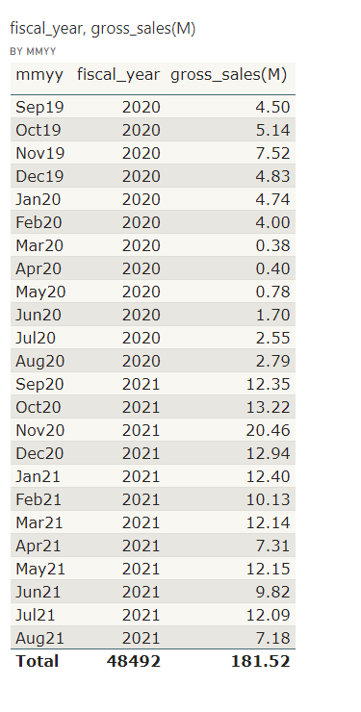
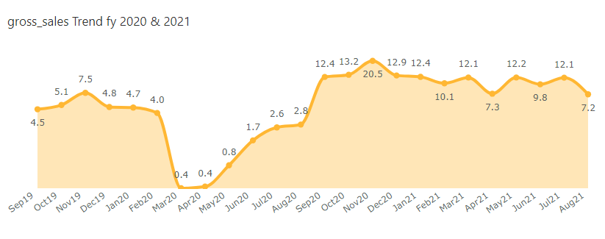
07
Get the complete report of the Gross sales amount for the customer “Atliq Exclusive” for each month . This analysis helps to get an idea of low and high-performing months and take strategic decisions.

Slide 15
KEY POINTS
FY 2020:
Sales were steady in Q1 and Q2.
Q3 saw a significant dip in performance.
Market started recovering in Q4.
FY 2021:
Q1 recorded the highest growth.
Q2 experienced another market dip.
Q3 and Q4 showed decent performance with minor fluctuations:
Some months performed better, others saw lower sales.
Overall, the company stabilized after the sharp dip in FY 2020 Q3 and Q4.
AtliQ Hardware Fiiscal year : September -August

Slide 16
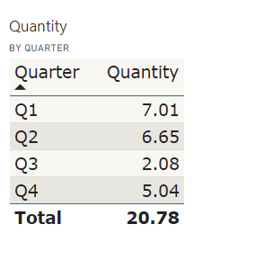
08
In which quarter of 2020, got the maximum total_sold_quantity?
The final output contains these fields Quarter total_sold_quantity
KEY POINTS
The company started strong in Q1 with a quantity of 7.01 million.
Q2 saw a slight decline to 6.65 million.
There was a significant dip in Q3, dropping to 2.08 million.
Q4 showed slight recovery, reaching 5.04 million.
Fiscal Year: september -august, Q1: sept-oct-nov, Q2: dec-jan-feb, Q3:mar-apr-may, Q4: jun-july-Aug

Slide 17
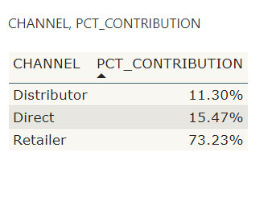
09
Which channel helped to bring more gross sales in the fiscal year 2021 and the percentage of contribution?
The final output contains these fields, channel gross_sales_mln percentage
KEY POINTS
AtliQ Hardware uses three distribution channels: Retailers, Direct Sales, and Distributors.
Retailers contribute the highest share with 73.23% of total sales.
Direct Sales account for 15.47%.
Distributors contribute the remaining 11.30%.

Slide 18
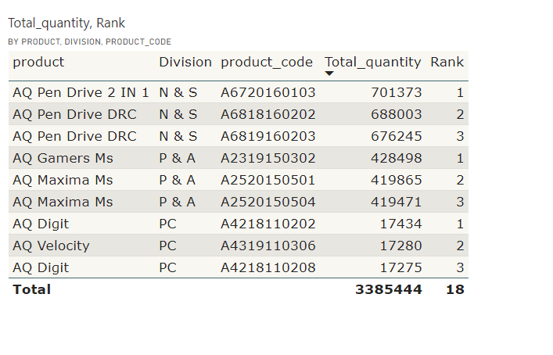
10
Get the Top 3 products in each division that have a high total_sold_quantity in the fiscal_year 2021?
The final output contains these fields, division product_code
KEY POINTS
The top 3 best-selling products from each segment have been identified based on total quantity sold across
Network & Storage
Peripherals&Accessories
and Personal Computers.

Slide 19
THANK YOU

